Slide 1

Technical Session: SQL Tuning –
Tips, Tools, Techniques & Best Practices

Slide 2
Overview
Recap ‘Proof Of Technology’ Presentation
SQL Tuning Tips
SQL Tuning Process
SQL Tuning Tools
SQL Tuning Techniques
Best Practices

Slide 3
Recap ‘Proof Of Technology’ Presentation _{[2]}

Slide 4



Why ‘Proof Of Technology’
The reasons for POT were
Management: ‘Atune is the future’
+ =
But.. Atune is unproven on large deployments
‘Can Atune scale?’
  Big funds (eg RESTx2 – 3 million active members)
  Big employers (eg. Woolworths ~200k employers)
  Lots of users (600 web, 400 administrators)
  Interactive response times + batch windows

Slide 5



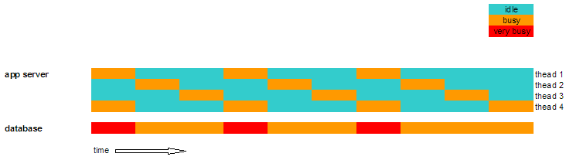
What did we do?
Establish environment
Identify acceptance criteria
Take a performance baseline
Tune the application
Run POT Tests
STATSPACK

Slide 6
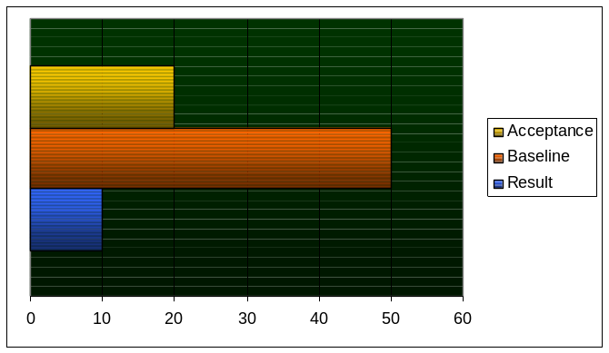

How were the results ?
Just Great!!
What does this mean for aaspire?
It is confirmed as the platform of choice for AAS – next 15-20 years
Credibility with users, administrators, clients and the industry
It means we can chase new business and grow AAS
It means we have some work to do!
Tune

Slide 7




Where do we begin?
Make Friends With Jprofiler
Learn Basic Query Tuning
Be Performance Aware
Think Big !!!
ORACLE SQL Developer

Slide 8
SQL Query Tuning _{[1],[3],[5],[6]}

Slide 9
Why Tune SQL
SQL Tuning sometime takes even longer than writing and testing the SQL
We however undertake the difficult process of tuning the SQL to :
  Ensure scalability in our application
  Improve the interactive response time of an Oracle based application
  Improve batch throughput
Exponential
  Reduce System load
Constrained
  Avoid hardware upgrades
Performace (resp time / thr put)
Linear
Scalability is a system's ability to process more workload, with a proportional increase in system resource usage.
Nearly Static
Load on the system (no of rows/ users)
Patterns of scalability
Notes:
Improve the interactive response time of an Oracle based application
- a major component of response time is generally time taken to retrieve or update data. Bu tuning the SQL the response time can be dramativaly reduced.
Improve batch throughput
- will allow more rows to be processed with a given time allowing the job to be completed with the given window.
Ensure scalability in our application
- As load (no of users or the data) is increased, we hope the performance degrades gradually - The truth is – it doesnot happen so -
Reduce System load
Even performance is within acceptable limits – tuning the application can free p system response for other purposes
Avoid hardware upgrades
poor performing applications generaly have to go for costly hardware upgrades just to “make it work”, but is generally non-scalable as it may ultimately be non-viable /affordable

Slide 10
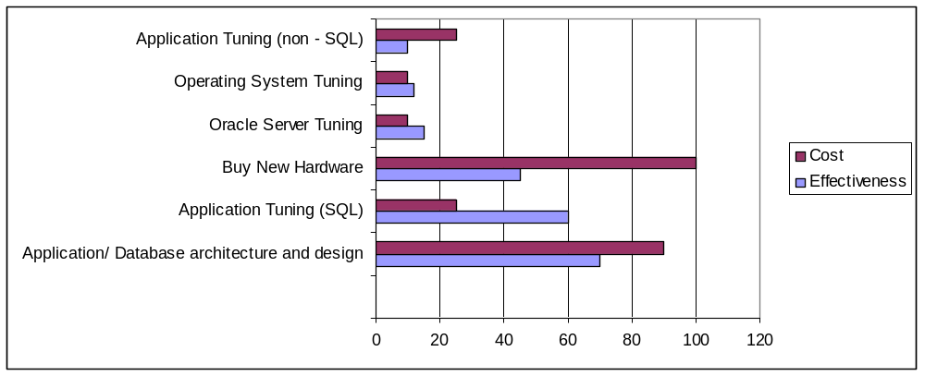
Why Tune SQL
approximately 60% of all Oracle system performance problems are resolved by coding optimal SQL.
It is less expensive and can offer greater improvements the earlier its addressed in the SDLC.
It may be the only available tuning measure for production systems

Slide 11
SQL Tuning Objective
SQL Tuning Objective is to
  improve the response time or throughput of a query
  returning the desired correct results (keeping the functionality)
  using acceptable resources/time for tuning
SQL tuning quality depends on
  Realistic or representative data volumes
  Accuracy of measurements
  Documentation of database and application design
  Quality of tuning tools available
  Knowledge of how SQL works in the database
Lets see how a query is processed by ORACLE …….

Slide 12
How is SQL Processed By the Database
SQL Statement
Output
Parser
Soft Parse
Hard Parse
Optimizer
RBO
Statistics
Row Source Generator
SQL Execution
CBO

Slide 13
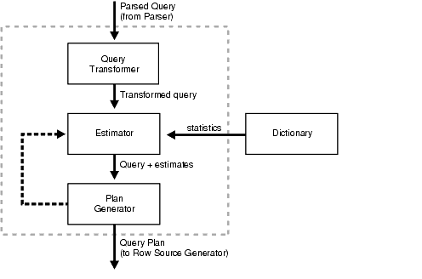
The optimizer at work
SQL Tuning is about getting the right Plan to work.
Parsing stage makes the main difference
Lets look at a few Tips to write better SQL …

Slide 14
Better SQL – Tip #1
Make use of the available index
  Don't perform operations on database objects referenced in the WHERE clause – Oracle will ignore the index
Do Not Use
Use
SELECT TRN511_ENTTYP, TRN511_ENTIDE, TRN511_TRNEFF
FROM TRN511
WHERE UPPER(TRN511_ENTTYP) = ‘*PLA';
SELECT TRN511_ENTTYP, TRN511_ENTIDE, TRN511_TRNEFF
FROM TRN511
WHERE TRN511_ENTTYP = ‘*PLA';
SELECT TRN511_ENTTYP, TRN511_ENTIDE, TRN511_ TRNEFF
FROM TRN511
WHERE TRN511_ENTTYP = NVL ( :1, TRN511_ENTTYP);
SELECT TRN511_ENTTYP, TRN511_ENTIDE, TRN511_TRNEFF
FROM TRN511
WHERE TRN511_ENTTYP LIKE NVL ( :1, ‘%’);
SELECT TRN511_ENTTYP, TRN511_ENTIDE, TRN511_ TRNEFF
FROM TRN511
WHERE TRUNC (TRN511_TRNEFF) = TRUNC (SYSDATE);
SELECT TRN511_ENTTYP, TRN511_ENTIDE, TRN511_ TRNEFF
FROM TRN511
WHERE TRN511_TRNEFF >= TRUNC (SYSDATE) AND TRN511_TRNEFF < TRUNC (SYSDATE) + 1;

Slide 15
Better SQL – Tip #1
  Don't perform operations on database objects referenced in the WHERE clause – Oracle will ignore the index
Do Not Use
Use
SELECT TRN511_ENTTYP, TRN511_ENTIDE, TRN511_ TRNEFF
FROM TRN511
WHERE TRN511_ENTTYP || TRN511_TRNSTA = ‘*PLA1';
SELECT TRN511_ENTTYP, TRN511_ENTIDE, TRN511_ TRNEFF
FROM TRN511
WHERE TRN511_ENTTYP = ‘*PLA'
AND TRN511_TRNSTA = 'A';
SELECT TRN511_ENTTYP, TRN511_ENTIDE, TRN511_ TRNEFF
FROM TRN511
WHERE TRN511_PSTVAL + 3000 < 5000;
SELECT TRN511_ENTTYP, TRN511_ENTIDE, TRN511_ TRNEFF
FROM TRN511
WHERE TRN511_PSTVAL < 2000;
SELECT TRN511_ENTTYP, TRN511_ENTIDE, TRN511_ TRNEFF
FROM TRN511
WHERE TRN511_PSTVAL <> 0;
SELECT TRN511_ENTTYP, TRN511_ENTIDE, TRN511_ TRNEFF
FROM TRN511
WHERE TRN511_PSTVAL > 0;
SELECT TRN511_ENTTYP, TRN511_ENTIDE, TRN511_ TRNEFF
FROM TRN511
WHERE TRN511_PSTVAL NOT = 0;
SELECT TRN511_ENTTYP, TRN511_ENTIDE, TRN511_ TRNEFF
FROM TRN511
WHERE TRN511_PSTVAL > 0;

Slide 16
Better SQL – Tip #2
Share SQL statement. If SQL is not shared, it will take up too much resource parsing. We have this issue in EDI processing.
Non-sharable SQL
insert into EDI020 (edi020_sta,edi020_ediseq,edi020_pmeide,edi020_ediide) values ('0',44979,NULL,900006307)
insert into EDI020 (edi020_sta,edi020_ediseq,edi020_pmeide,edi020_ediide) values ('0',44906,NULL,900006307)
Sharable SQL
insert into EDI020 (edi020_sta,edi020_ediseq,edi020_pmeide,edi020_ediide) values (:B1,:B2,:B3,:B4)
Bind value: b1=’0’
b2=44979
b3 = NULL
b4 = 900006307
insert into EDI020 (edi020_sta,edi020_ediseq,edi020_pmeide,edi020_ediide) values (:B1,:B2,:B3,:B4)
Bind value: b1=’0’
b2=44906
b3 = NULL
b4 = 900006307

Slide 17
Better SQL – Tip #3
Don't forget to tune views. Views are SELECT statements and can be tuned in just the same way as any other type of SELECT statement can be. All tuning applicable to any SQL statement are equally applicable to views.
Some of them unnecessarily have multi table lookups and outer joins
Eg MEMORPMEVIEW
CREATE OR REPLACE VIEW ATU_DATA.MEMORPMEVIEW3
as
SELECT /*+ FIRST_ROWS */ '*PLAMEM' as entity
, mem101.mem101_memide as memide
, mem101.mem101_plaide as plaide
, mem101.mem101_pmeide as pmeide
, mem101.mem101_pmeref as pmeref
, mem011.mem011_surnam as surnam
, mem011.mem011_givnam as givnam
, mem011.mem011_dob as dob
, mem011.mem011_sexide as gender
, pla011.pla011_deslon as plades
, mem101.mem101_sta as sta
FROM mem101, pla011, mem011
WHERE mem101_plaide = pla011_plaide
AND mem101_memide (+) = mem011_memide
ORDER BY mem101.mem101_pmeide ;

Slide 18
Better SQL – Tip #4
Know the database table structure and column data type. This will simplify the SQL you are writing
Unnecessary Function calls
select NVL(MIN(TO_NUMBER(edi024_sta)), 0)
from edi024 where edi024_ediide = :1
EDI024_STA is a NOT NULL Column
Change to
select MIN(edi024_sta)
from edi024 where edi024_ediide = :1
MIN can be used for VARCHAR2 Columns

Slide 19
Better SQL – Tip #5
Should be in WHERE not HAVING
HAVING clauses should only be used when columns with aggregate operations applied to them are restricted by the clause.
Do Not Use
Use
SELECT region, AVG (loc_size)
FROM location
GROUP BY region
HAVING region != 'SYDNEY'
AND region != 'PERTH';
SELECT region, AVG (loc_size)
FROM location
WHERE region != 'SYDNEY'
AND region != 'PERTH';
GROUP BY region;

Slide 20
Better SQL – Tip #6
Minimize the number of table lookups (subquery blocks) in queries, particularly if your statements include subquery SELECTs or multicolumn UPDATEs.
Multiple table calls
SELECT fmu013_effdat, MAX(fmu013_effseq) AS seq
FROM FMU013
WHERE fmu013_fmuent = '*PLAMEM'
AND fmu013_fmuide = 'MAST1_1001'
AND fmu013_effdat <= to_date('2007-01-10', 'YYYY-MM-DD')
AND fmu013_effdat IN (
SELECT fmu013_effdat
FROM FMU013
WHERE fmu013_sta = '1'
AND fmu013_fmuent = '*PLAMEM'
AND fmu013_fmuide = 'MAST1_1001'
AND fmu013_effseq IN (
SELECT MAX(fmu013_effseq)
FROM FMU013
WHERE fmu013_fmuent = '*PLAMEM'
AND fmu013_fmuide = 'MAST1_1001'
GROUP BY fmu013_effdat
)
)
GROUP BY fmu013_effdat
ORDER BY fmu013_effdat DESC, seq DESC
/

Slide 21
Better SQL – Tip #6
Minimize the number of table lookups (subquery blocks) in queries, particularly if your statements include subquery SELECTs or multicolumn UPDATEs.
Single Table Call
select fmu013_effdat, max_effseq
from
( select fmu013_effdat, MAX(fmu013_effseq) over ( partition by
fmu013_fmuent, fmu013_fmuide, fmu013_effdat ) max_effseq,
fmu013_sta, fmu013_effseq
FROM FMU013
where fmu013_fmuent = '*PLAMEM'
AND fmu013_fmuide = 'MAST1_1001'
)
where fmu013_effdat <= to_date('2007-01-10', 'YYYY-MM-DD')
and fmu013_sta = 1
and fmu013_effseq = max_effseq
/

Slide 22
Better SQL – Tip #7
EXISTS, IN-LIST OR TABLE JOIN for Subqueries?
Consider the alternatives EXISTS, IN and table joins when doing multiple table joins.
None of these are consistently faster; it depends on your data.
IN
EXISTS
Query
Select * from T1 where x in ( select y from T2 )
select * from t1 where exists ( select null from t2 where y = x )
Processed as
select *
from t1, ( select distinct y from t2 ) t2
where t1.x = t2.y;
for x in ( select * from t1 )
loop
if ( exists ( select null from t2 where y = x.x )
then
OUTPUT THE RECORD
end if
end loop
What it means
The subquery is evaluated, distinct'ed, indexed (or hashed or sorted) and then joined to the original table -- typically.
whereas the first query can make use of an index on T1(x).
It always results in a full scan of T1
It will use an index on T2(y)
Where it is used?
When the result of the subquery is small
When the result of the subquery ( select y from T2 ) is "huge" and takes a long time. But the table T1 is relatively small.
Use Either?
When size of T1 is same as T2

Slide 23
Better SQL – Tip #8
EXISTS, IN-LIST OR TABLE JOIN for Co-related Subqueries?
Consider the alternatives EXISTS, IN and table joins when doing multiple table joins.
IN and EXISTS work similarly in co-related subqueries when the subquery uses an index and returns few rows.
JOIN
EXISTS
IN LIST
select adj011.*
from adj011, adj012
where
adj011_heaide = adj012_heaide and
adj012_linide is null and
(adj011_sta IN ('0', '1', '2' ) )
order by adj011_heaide asc
select adj011.*
from adj011
where exists (select 1 from adj012 where
adj011_heaide = adj012_heaide and
adj012_linide is null )
and (adj011_sta IN ('0', '1', '2' ) )
order by adj011_heaide asc
select adj011.*
from adj011
where adj011_heaide in (select adj012_heaide from adj012 where
adj011_heaide = adj012_heaide and
adj012_linide is null )
and (adj011_sta IN ('0', '1', '2' ) )
order by adj011_heaide asc

Slide 24
Better SQL – Tip #9
NOT IN and NOT EXISTS may not be the same – use wisely
It depends if the joining column values are null
If values are null use NOT EXISTS
If values are NOT NULL, NOT IN will perform better.

Slide 25
Better SQL – Tip #10
Avoid the DISTINCT qualifier on the SELECT list in queries at the owner end of a one-to-many relationship.
The DISTINCT operator causes Oracle to fetch all rows satisfying the table join and then sort and filter out duplicate values.
EXISTS is a faster alternative, because the Oracle optimizer realizes when the subquery has been satisfied once, there is no need to proceed further and the next matching row can be fetched.
Do Not Use
Use
Select DISTINCT mem011_memide, mem011_surname, mem011_givnam
from mem011, mem101
Where mem101_memide = mem011_memide
And mem101_plaide = :b1
Select mem011_memide, mem011_surname, mem011_givnam
from mem011
Where exists (select ‘X’ from mem101
Where mem101_memide = mem011_memide
And mem101_plaide = :b1);

Slide 26
Better SQL – Tip #11
Outer Joins are very powerful and if suitably used can reduce the number of table lookups.
Avoid Outer joins that are not necessary and confusing to you and the optimiser -
SELECT /*+ FIRST_ROWS */ '*PLAMEM' as entity
, mem101.mem101_memide as memide
, mem101.mem101_plaide as plaide
, mem101.mem101_pmeide as pmeide
, mem101.mem101_pmeref as pmeref
, mem011.mem011_surnam as surnam
, mem011.mem011_givnam as givnam
, mem011.mem011_dob as dob
, mem011.mem011_sexide
, pla011.pla011_deslon as plades
, mem101.mem101_sta as sta
FROM mem101, pla011, mem011
WHERE mem101_plaide = pla011_plaide
AND mem101_memide(+) = mem011_memide

Slide 27
Better SQL – Tip #12
If the results fed into a UNION are known to be unique, replace UNION with UNION ALL
UNION in a SQL query will combine the results of two sub-queries, filtering out any duplicates.
Replacing UNION with UNION ALL will just return the combined results without checking for duplicates; less work for the database!
Replace
With Union ALL
SELECT edi070_ediide, edi070_ediseq, edi070_actunt, edi070_sta
FROM edi070, trd021, trn021, mem101, mem011, inv013
WHERE ………………
AND (edi070_sta = '2' or edi070_sta = '3')
UNION
SELECT edi070_ediide, edi070_ediseq, edi070_actunt, edi070_sta,
FROM edi070, mem101, mem011
WHERE ……………
AND(edi070_sta <> '2' and edi070_sta <> '3')
SELECT edi070_ediide, edi070_ediseq, edi070_actunt, edi070_sta
FROM edi070, trd021, trn021, mem101, mem011, inv013
WHERE edi070_trnide = trd021_trnide
AND ………………
AND (edi070_sta = '2' or edi070_sta = '3')
UNION ALL
SELECT edi070_ediide, edi070_ediseq, edi070_actunt, edi070_sta,
FROM edi070, mem101, mem011
WHERE ………
AND(edi070_sta <> '2' and edi070_sta <> '3')

Slide 28
Better SQL – Tip #13
Use DECODE or CASE and scalar subqueries to selectively select from different tables/rows in a single query
SELECT trn511_plaide, trn511_enttyp, trn511_entide, trn511_pstdat,
(CASE trn511_trngrp
WHEN '*CLM'
THEN (SELECT clm005_dessho
FROM clm011, clm005
WHERE trn511_trnide = clm011_trnide
AND trn511_plaide = clm005_plaide
AND clm005_clmtyp = clm011_clmtyp)
WHEN ………..
WHEN '*FEE'
THEN (SELECT fee011_dessho
FROM fee011
WHERE trn511_trncde = fee011_feetyp
AND trn511_enttyp = fee011_feeent)
ELSE 'Not Applicable'
END
) shortdescr
FROM trn511, trn512, trn005, mem101, emp101,......

Slide 29
Better SQL – Tip #14
Beware of Unrestricted Conditions
  MEM101_PMEIDE > :5
There must be a reason for such queries
Check if the application is restricting rows
Original
Modified
Consider this?
select * from mem101 where
(mem101_plaide = :1 and (upper( mem101_sta ) = :2 or
upper( mem101_sta ) = :3) and
mem101_credat < :4 + 1 and mem101_pmeide > :5)
order by mem101_pmeide asc
select * from mem101 where
(mem101_plaide = :1 and (upper( mem101_sta ) = :2 or
upper( mem101_sta ) = :3) and
mem101_credat < :4 + 1 and mem101_pmeide between :5 and :6)
order by mem101_pmeide asc
Select * from (Select a.*, rownum rn from (select * from mem101 where
(mem101_plaide = :1 and (upper( mem101_sta ) = :2 or
upper( mem101_sta ) = :3) and
mem101_credat < :4 + 1) a
order by mem101_pmeide asc ) where rownum <= :5)
where rn >= :6

Slide 30
Better SQL – Tip #15
Oracle automatically performs simple column type conversions (or casting) when it compares columns of different types.
Depending on the type of conversion, indexes may not be used.
Declare your program variables as the same type as your Oracle columns
Data type
Query
After Implicit Conversion
Index Used?
* TRN021_STA NUMBER (INDEXED)
select * from trn021 where trn021_sta = ‘1’;
select * from trn021 where trn021_sta = to_number(‘1’);
YES
TRN021_STA VARCHAR2 (INDEXED)
select * from trn021 where trn021_sta = 1;
select * from trn021 where to_number(trn021_sta) = 1;
NO

Slide 31
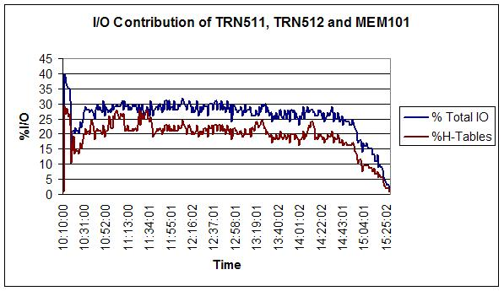
Better SQL – Tip #16
Exercise caution for large tables with many indexes.
TRN511,512,513 + MEM101 contribute to over 75% of total database I/O

Slide 32
SQL Tuning Process _{[1]}

Slide 33
SQL Tuning Process
Start application
Reproduce issue /run new application component
Finish
Prepare for Tuning
Save Stats/ Plan
Prepare for Tuning
Prepare Test Data
Setup Profiler
Have tools ready
YES
Run SQL
Capture Plan / Stats
Is SQL Optimised ?
Run, Profile and Measure BASELINE
Tune
NO
Tune SQL
Review Plan, Statistics Formulate Options
Is it Optimal?
NO
Identify Component
YES
Reword SQL
Use Alternate Technique
Add / Change Index
Save BASELINE
Finish

Slide 34
SQL Tuning Process
Prepare for Tuning
  The correct data size and composition
  Know the database structural design (tables/indexes/constraints)
  Know the requirements SLAs – when to stop.
  Know the tools to measure SQL Performance
Know tools to profile, measure and tune
Measure performance as you tune
SQL tuning can involve a
  rewording SQL,
  using a alternate technique like analytics, Hints, scalar subquery
  changing database structure – denormalize, add index
Tuning is Iterative
Stop where and when necessary
Notes:
You may require the following:
An understanding of how Oracle process SQL
An understanding of table volumes and relationships
An understanding of how you can influence Oracle’s processing
Understanding of how to make the most of indexes and clustering
An awareness of possible alternative approaches to various types of SQL statements

Slide 35
Tuning Tools _{[6], [4]}

Slide 36
Tuning Tools
Profiling
  Jprofiler
  STATSPACK
  SQL Trace and tkprof
Measuring
  Jprofiler
  Application Statistics
  STATSPACK / Query Database Dictionary
  Autotrace
  SQLTrace and tkprof
Tuning
  Explain plan
  Predicate details
  Toad/ SQLlab/SQL Developer/ SQLPLUS/ OEM

Slide 37
What do you measure
The following SQL query related statistics are most helpful for tuning:
Elapsed Time
CPU Time
Disk Reads
Memory Buffer Reads
Number of Executions
Number of Rows Processed
Parse calls

Slide 38
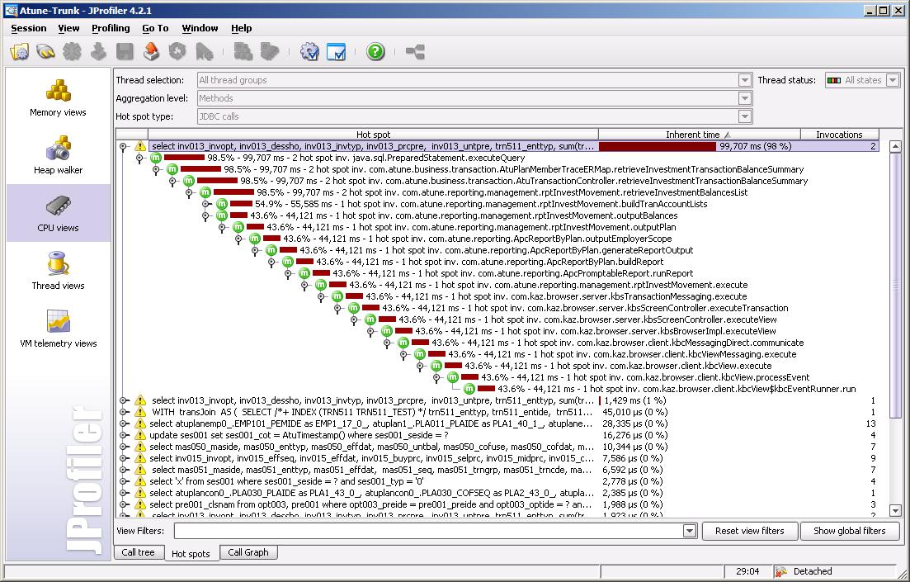
JProfiler
Start using the Jprofiler – Instructions are in Confluence….

Slide 39
Oracle Statspack
The Statspack package collects database performance statistics.
The data collected provides information on
  Database instance efficiency
  database load profile
  high resource SQL statements,
  Performance bottlenecks
  Database I/O profile
You take a snapshot before and after your test or at specific intervals and prepare a baseline report.
Main reports are :
  Spreport.sql - Oracle provided script to extract comprehensive report.
  Sp_sqlrep.sql – Script to get the top SQLs for profiling.

Slide 40
Oracle Statspack
Output of STATSPACK report sp_sqlrep.sql
SQL statements ordered by Elapsed Time (Sec) for snap range 42 - 44
Elapsd CPU
Hash Value Time (s) Time (s) Buffer Gets Physical Reads Executions Parse Calls Rows Proce
---------- --------- -------- --------------- --------------- ------------ ------------ -----------
3048964771 15646.00 9640.21 2,395,657,689 5,004 3,599 3,599 18,005
608080323 4612.90 15.63 961,364 2,211 24,038 14,569 24,027
173269282 2770.55 17.15 732,810 3,091 63,760 15,948 63,735
4270193260 1662.45 1.04 67,967 2 2,963 1,580 2,942
450302795 1501.02 916.84 261,238,471 0 7,084 5,222 0
4005541200 1020.65 675.66 151,150,164 0 3,491 3,491 3,186
1740509657 897.00 601.87 9,641,311 4,745 76,655 16,058 76,657
2306139321 811.56 23.10 614,545 146,321 3,993 3,993 660,329
4248007786 585.30 406.48 35,753,846 0 7,146 7,146 2,417,595
Output of STATSPACK report spreport.sql
Top 5 Timed Events Avg %Total
~~~~~~~~~~~~~~~~~~ wait Call
Event Waits Time (s) (ms) Time
----------------------------------------- ------------ ----------- ------ ------
db file sequential read 38,714,392 511,007 13 90.7
log file sync 248,683 13,491 54 2.4
db file parallel write 456,514 11,881 26 2.1
CPU time 11,209 2.0
log file parallel write 233,162 9,247 40 1.6

Slide 41
EXPLAIN PLAN
A statement's execution plan is the sequence of operations Oracle performs to run the statement.
The EXPLAIN PLAN statement displays execution plans chosen by the Oracle optimizer for SELECT, UPDATE, INSERT, and DELETE statements.
The row source tree is the core of the execution plan. It shows the following information:
  An ordering of the tables referenced by the statement
  An access method for each table mentioned in the statement
  A join method for tables affected by join operations in the statement
  Data operations like filter, sort, or aggregation
The EXPLAIN PLAN results let you understand the performance of a query.

Slide 42
EXPLAIN PLAN and DBMS_PLAN
SQL> explain plan for select * from pla011 where pla011_plaide in (1,2,3,4,5,6,7,8,9,10);
Explained.
SQL> @?/rdbms/admin/utlxpls
PLAN_TABLE_OUTPUT
----------------------------------------------------------------------------
| Id | Operation | Name | Rows | Bytes | Cost |
----------------------------------------------------------------------------
| 0 | SELECT STATEMENT | | 10 | 1250 | 2 |
| 1 | INLIST ITERATOR | | | | |
| 2 | TABLE ACCESS BY INDEX ROWID| PLA011 | 10 | 1250 | 2 |
|* 3 | INDEX RANGE SCAN | PLA011_PK | 10 | | 1 |
----------------------------------------------------------------------------
Predicate Information (identified by operation id):
---------------------------------------------------
3 - access("PLA011"."PLA011_PLAIDE"=1 OR "PLA011"."PLA011_PLAIDE"=2 OR
"PLA011"."PLA011_PLAIDE"=3 OR "PLA011"."PLA011_PLAIDE"=4 OR
"PLA011"."PLA011_PLAIDE"=5 OR "PLA011"."PLA011_PLAIDE"=6 OR
"PLA011"."PLA011_PLAIDE"=7 OR "PLA011"."PLA011_PLAIDE"=8 OR
"PLA011"."PLA011_PLAIDE"=9 OR "PLA011"."PLA011_PLAIDE"=10)
Note: cpu costing is off

Slide 43
EXPLAIN PLAN Predicate Information
SQL> explain plan for select * from trn021 where trn021_sta = 1;
Explained.
SQL> @?/rdbms/admin/utlxpls
PLAN_TABLE_OUTPUT
-------------------------------------------------------------------------------
--------------------------------------------------------------------
| Id | Operation | Name | Rows | Bytes | Cost |
--------------------------------------------------------------------
| 0 | SELECT STATEMENT | | 1.4M | 175M | 12340 |
|* 1 | TABLE ACCESS FULL | TRN021 | 1.4M | 175M | 12340 |
--------------------------------------------------------------------
Predicate Information (identified by operation id):
---------------------------------------------------
PLAN_TABLE_OUTPUT
-------------------------------------------------------------------------------
1 - filter(TO_NUMBER(“TRN021".“TRN021_STA")=1)
Note: cpu costing is off

Slide 44
Reviewing the Explain Plan
In an OLTP environment, the goal is to drive from the table that has the most selective filter.
When examining the optimizer execution plan, look for the following:
  the driving table has the best filter.
  the join order in each step means that the fewest number of rows are being returned to the next step
  The join method is appropriate for the number of rows being returned.
  Views are used efficiently. Look at the SELECT list to see whether access to the view is necessary.
  There are any unintentional Cartesian products
  Consider the predicates in the SQL statement and the number of rows in the table.
  A full table scan does not mean inefficiency
  Check if the query is using the most suitable Index

Slide 45
Explain Plan Example
select adj011.*
from adj011, adj012
where
adj011_heaide = adj012_heaide and
adj012_linide is null and
(adj011_sta IN ('0', '1', '2' ) )
order by adj011_heaide asc
------------------------------------------------------------------------------------
| Id | Operation | Name | Rows | Bytes |TempSpc| Cost |
------------------------------------------------------------------------------------
| 0 | SELECT STATEMENT | | 5920K| 632M| | 125K|
| 1 | MERGE JOIN | | 5920K| 632M| | 125K|
|* 2 | TABLE ACCESS BY INDEX ROWID| ADJ011 | 5908K| 585M| | 104K|
| 3 | INDEX FULL SCAN | ADJ011_PK | 5908K| | | 13021 |
|* 4 | SORT JOIN | | 5920K| 45M| 181M| 21010 |
|* 5 | TABLE ACCESS FULL | ADJ012 | 5920K| 45M| | 6140 |
------------------------------------------------------------------------------------
Predicate Information (identified by operation id):
---------------------------------------------------
2 - filter("ADJ011"."ADJ011_STA"='0' OR "ADJ011"."ADJ011_STA"='1' OR
"ADJ011"."ADJ011_STA"='2')
4 - access("ADJ011"."ADJ011_HEAIDE"="ADJ012"."ADJ012_HEAIDE")
filter("ADJ011"."ADJ011_HEAIDE"="ADJ012"."ADJ012_HEAIDE")
5 - filter("ADJ012"."ADJ012_LINIDE" IS NULL)
Note: cpu costing is off

Slide 46
Using Explain Plan to Tune
John created Histogram on the column ADJ011_STA and this changed the PLAN
--------------------------------------------------------------------------------
| Id | Operation | Name | Rows | Bytes | Cost |
--------------------------------------------------------------------------------
| 0 | SELECT STATEMENT | | 8 | 896 | 18 |
| 1 | SORT ORDER BY | | 8 | 896 | 18 |
|* 2 | TABLE ACCESS BY INDEX ROWID | ADJ012 | 1 | 8 | 1 |
| 3 | NESTED LOOPS | | 8 | 896 | 10 |
| 4 | INLIST ITERATOR | | | | |
| 5 | TABLE ACCESS BY INDEX ROWID| ADJ011 | 8 | 832 | 2 |
|* 6 | INDEX RANGE SCAN | ADJ011_IX01 | 8 | | 1 |
|* 7 | INDEX RANGE SCAN | ADJ012_IX02 | 1 | | |
--------------------------------------------------------------------------------
Predicate Information (identified by operation id):
---------------------------------------------------
2 - filter("ADJ012"."ADJ012_LINIDE" IS NULL)
6 - access("ADJ011"."ADJ011_STA"='0' OR "ADJ011"."ADJ011_STA"='1' OR
"ADJ011"."ADJ011_STA"='2')
7 - access("ADJ011"."ADJ011_HEAIDE"="ADJ012"."ADJ012_HEAIDE")
Note: cpu costing is off

Slide 47
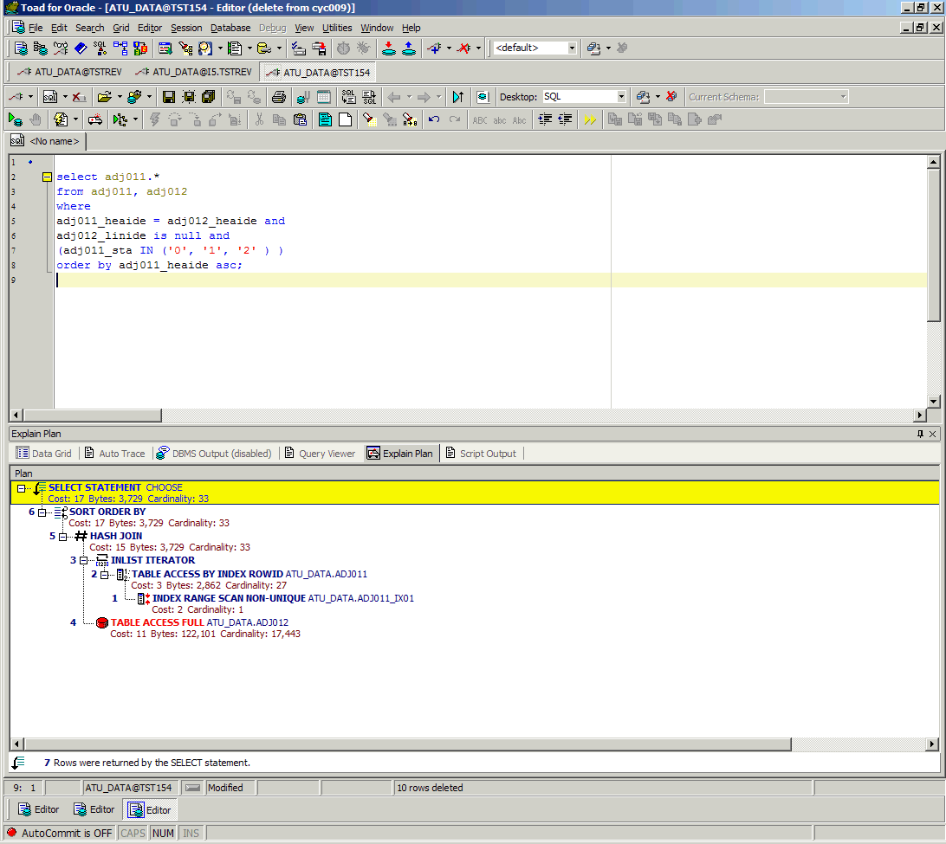
Explain Plan in TOAD

Slide 48
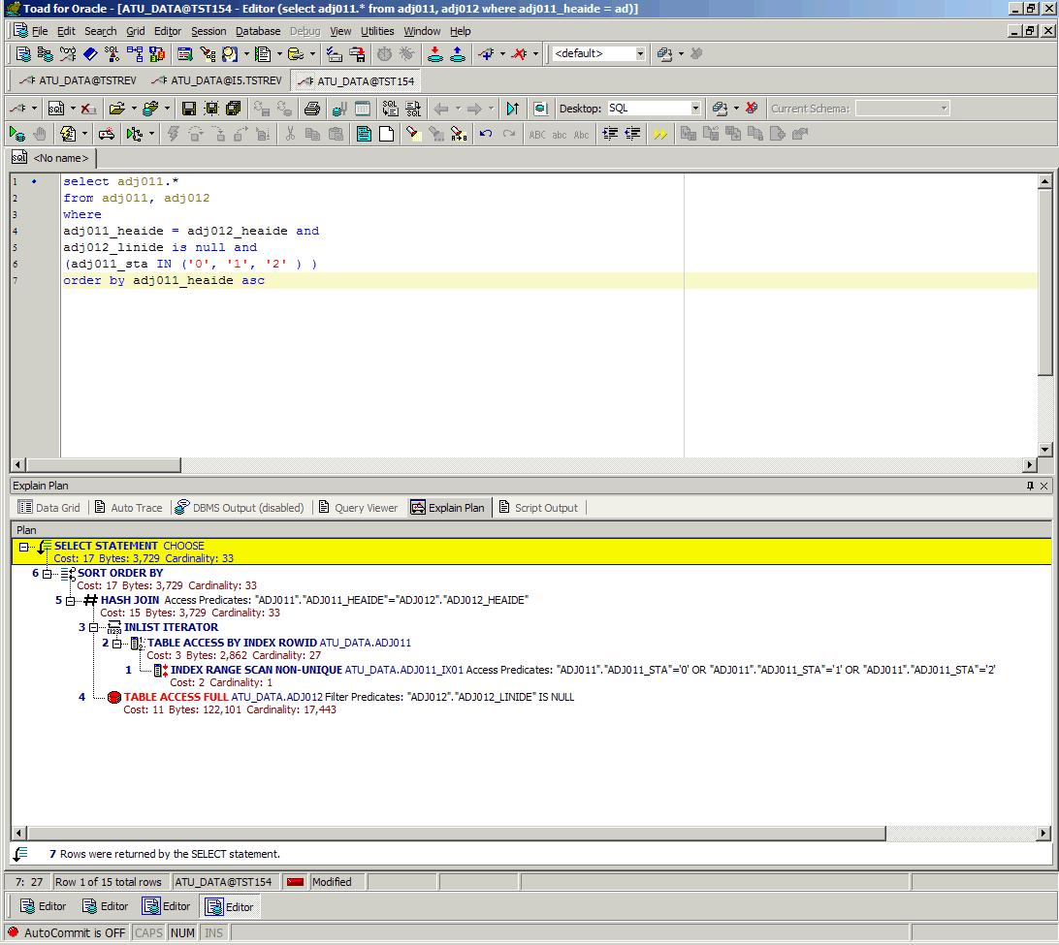
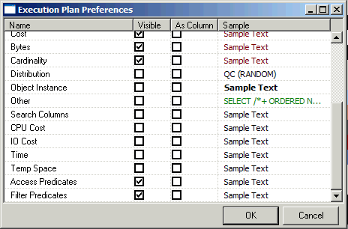
Predicate Information in TOAD

Slide 49
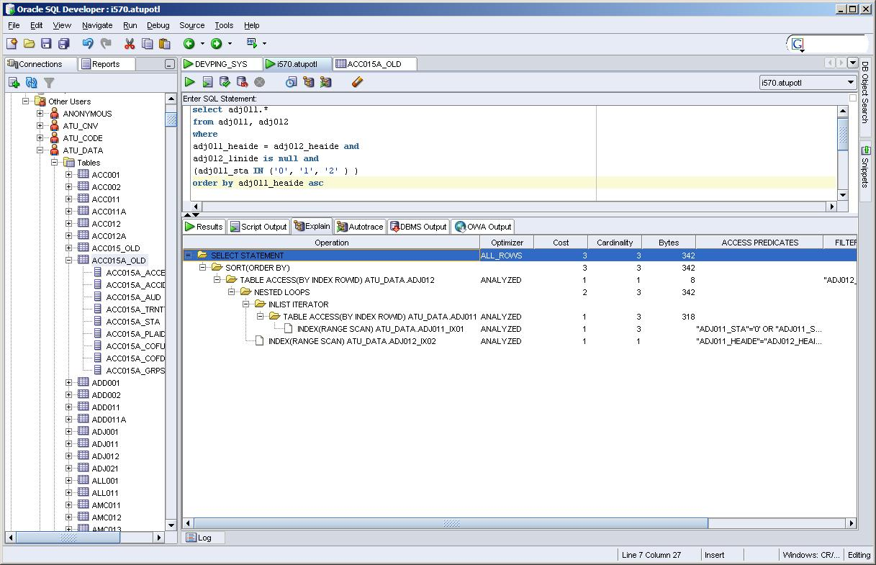
Explain Plan in SQL Developer

Slide 50
Explain Plan in DB Visualizer
Sorry Not There … Its not for you.
Use SQL Developer or Toad.

Slide 51
Using get_plan_details.sql
One of the utilities I wrote based on V$SQL_PLAN View
It display the execution plan and predicate details of a SQL statement
The advantage of V$SQL_PLAN over EXPLAIN PLAN is that you do not need to know the compilation environment that was used to execute a particular statement.
For EXPLAIN PLAN, you would need to set up an identical environment to get the same plan when executing the statement.
This can be very useful to know the actual PLAN of a query that ran in the database – using the bind variables.

Slide 52
Using get_plan_details.sql
SQL> select hash_value, sql_text from v$sql where sql_text like 'select adj011.*%';
HASH_VALUE SQL_TEXT
---------- -------------------------------------------------------
3021374629 select adj011.* from adj011 where exists (select 1 from adj012 where adj011_heaide = adj012_heaide and
adj012_linide is null ) and (adj011_sta IN (:1, :2, :3 ) ) order by adj011_heaide asc
SQL> @get_plan_details
Enter value for hash_value: 3021374629
Enter value for child_number: 0
STEP OPERATION OBJECT_NAME COST BYTES CARDINALITY
---------- -------------------------------------------------- ------------------------------ ---------- ---------- -----------
0, SELECT STATEMENT 59
1,0 SORT ORDER BY 59 3051 27
2,1 NESTED LOOPS SEMI 57 3051 27
3,2 INLIST ITERATOR
4,3 TABLE ACCESS BY INDEX ROWID ADJ011 3 2862 27
* 5,4 INDEX RANGE SCAN ADJ011_IX01 2 27
* 6,2 TABLE ACCESS BY INDEX ROWID ADJ012 2 122101 17443
* 7,6 INDEX RANGE SCAN ADJ012_IX02 1 1
---------- -------------------------------------------------- ------------------------------ ---------- ---------- -----------
Predicate Information (identified by operation id):
ID PREDICATES
---------- --------------------------------------------------------------------------------
5 ACCESS_PREDICATES: "ADJ011_STA"='0' OR "ADJ011_STA"='1' OR "ADJ011_STA"='2'
6 FILTER_PREDICATES; "ADJ012_LINIDE" IS NULL
7 ACCESS_PREDICATES: "ADJ011_HEAIDE"="ADJ012_HEAIDE"

Slide 53
Autotrace Utility
Autotrace produces a report after successful SQL statements on
  the execution path used by the SQL optimizer
  the statement execution statistics.
Statistic Name
Description
recursive calls
Number of internal SQL statements generated at both the user and system level.
db block gets
Number of times a CURRENT block was requested.
consistent gets
Number of times a consistent read was requested for a block
physical reads
Total number of data blocks read from disk.
redo size
Total amount of redo generated in bytes
bytes sent via SQL*Net to client
Total number of bytes sent to the client from the foreground processes.
bytes received via SQL*Net from client
Total number of bytes received from the client over Oracle Net.
SQL*Net roundtrips to/from client
Total number of Oracle Net messages sent to and received from the client
sorts (memory)
Number of sort operations that were performed completely in memory
sorts (disk)
Number of sort operations that required at least one disk write
rows processed
Number of rows processed during the operation

Slide 54
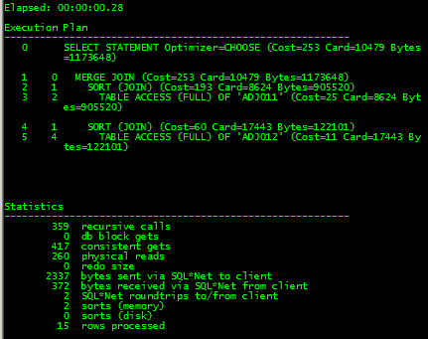
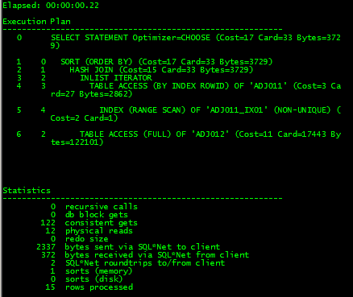
Autotrace
SET ATUOTRACE TRACEONLY TIMING ON
select adj011.*
from adj011, adj012
where
adj011_heaide = adj012_heaide and
adj012_linide is null and
(adj011_sta IN ('0', '1', '2' ) )
order by adj011_heaide asc
Without Histogram on ADJ011_STA
With Histogram on ADJ011_STA

Slide 55
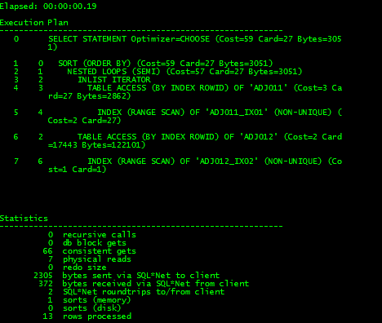
Autotrace
select adj011.*
from adj011
where exists (select 1 from adj012 where
adj011_heaide = adj012_heaide and
adj012_linide is null )
and (adj011_sta IN ('0', '1', '2' ) )
order by adj011_heaide asc
SET ATUOTRACE TRACEONLY TIMING ON
Prerequisites:
Requires PLUSTRACE ROLE
Access to internal statistics tables

Slide 56
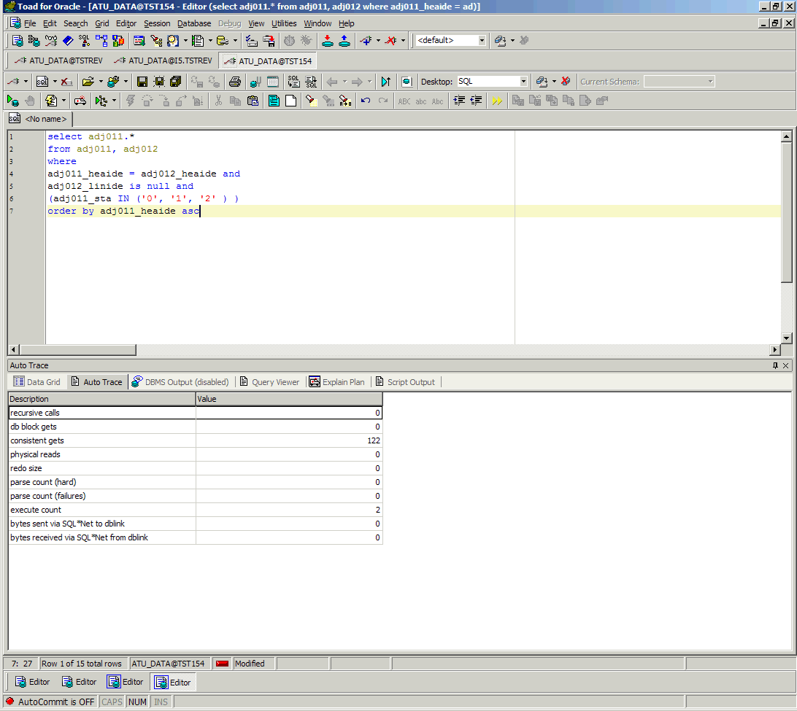
Autotrace in TOAD

Slide 57
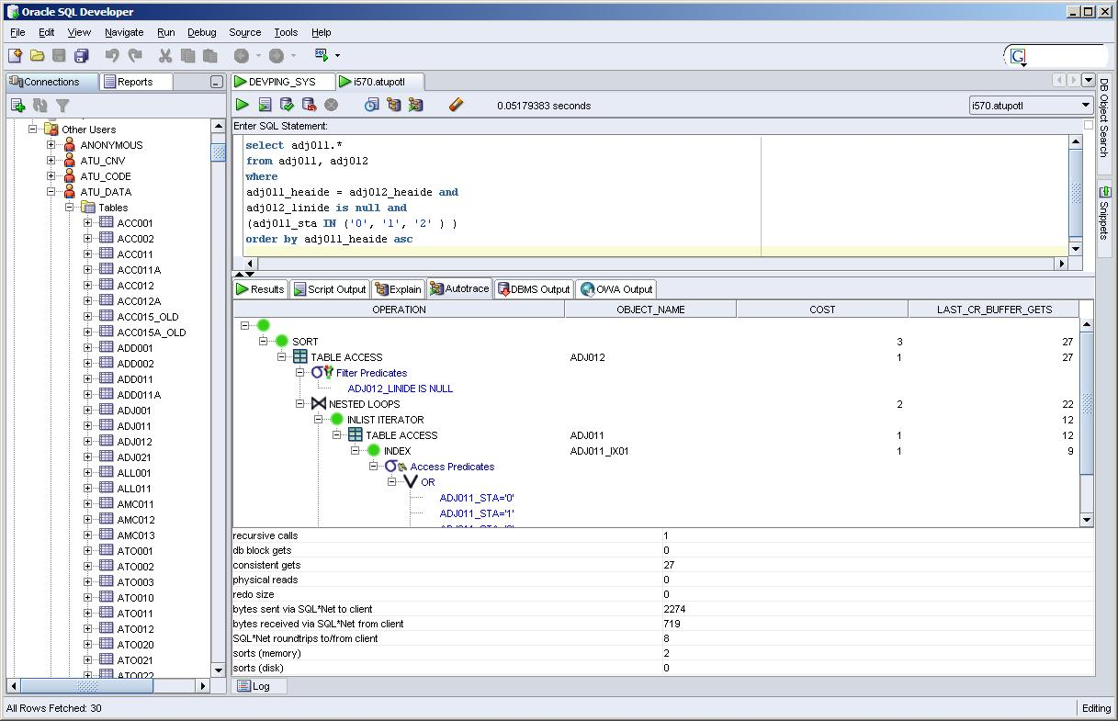
Autotrace in SQL Developer

Slide 58
SQL Trace and TKPROF
The SQL Trace facility is used to trace a application session.
TKPROF is used to format the trace file.
Helps to accurately assess the efficiency of the SQL statements an application runs.
Best suited for tracing a application session
It generates the following statistics for each statement:
  Parse, execute, and fetch counts
  CPU and elapsed times
  Physical reads and logical reads
  Number of rows processed
  Misses on the library cache
  Username under which each parse occurred
  Each commit and rollback
Can be instrumented to be called from the application

Slide 59
SQL Trace and TKPROF
A Typical output of TKPROF
update trn021 set trn021_sta = :1
Where exists ( select 1 from ctr021 where ctr021_trnide = trn021_trnide and
ctr021_heaide = :2 ) and trn021_sta <> '9‘
call count cpu elapsed disk query current rows
------- ------ -------- ---------- ---------- ---------- ---------- ----------
Parse 2506 0.00 0.03 0 0 0 0
Execute 2506 145.67 151.27 0 12367612 4250815 4113599
Fetch 0 0.00 0.00 0 0 0 0
------- ------ -------- ---------- ---------- ---------- ---------- ----------
total 5012 145.67 151.30 0 12367612 4250815 4113599
Elapsed times include waiting on following events:
Event waited on Times Max. Wait Total Waited
---------------------------------------- Waited ---------- ------------
SQL*Net message to client 2505 0.00 0.00
SQL*Net message from client 2505 0.01 2.09
rdbms ipc reply 321 0.00 0.03
log file sync 8 0.01 0.06
log file switch completion 2 0.01 0.02
********************************************************************************

Slide 60
New Tools in Oracle 10g _{[8]}
Oracle 10g has introduced advanced tools for SQL tuning
Called automatic tuning tools
Uses information from the new Active Session History (ASH)
Gets advise from other advisors, AWR and ADDM
Has a SQL Tuning Advisor and a SQL Access Advisor that can advise and let you implement improved recommendations on the fly.
Oracle Enterprise Manager 10g has GUI interface for these Automated tools and is free for Development purpose.
10g Autotrace also provides predicate information

Slide 61
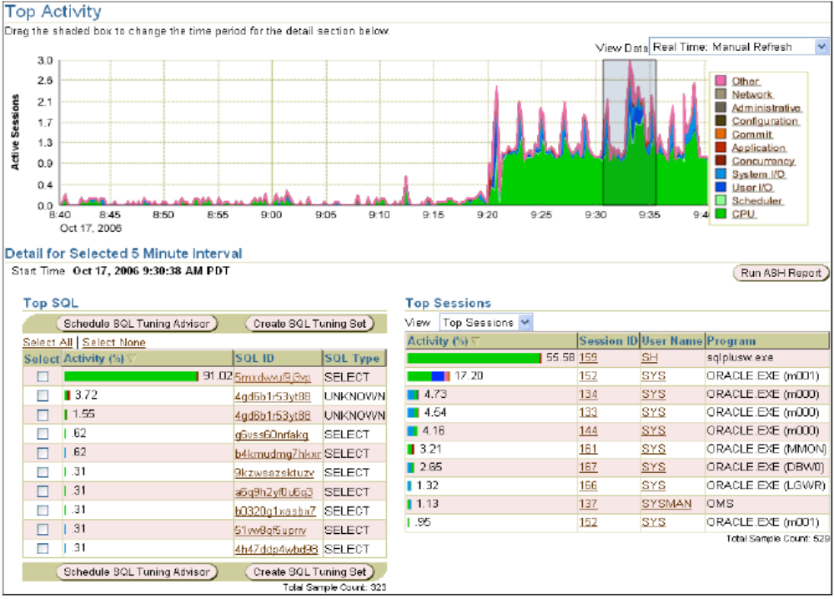
Enterprise Manager 10g

Slide 62
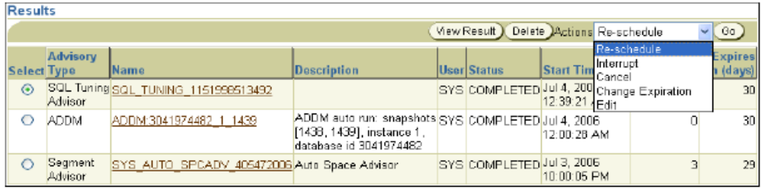
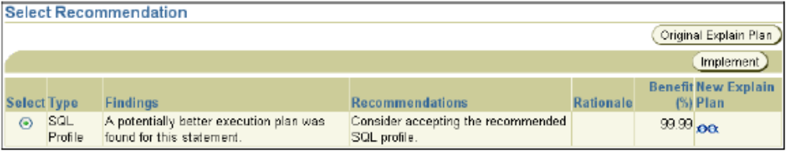
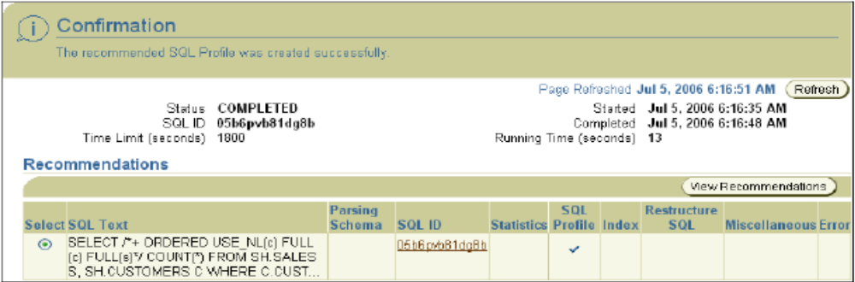
Automatic SQL tuning in 10g

Slide 63
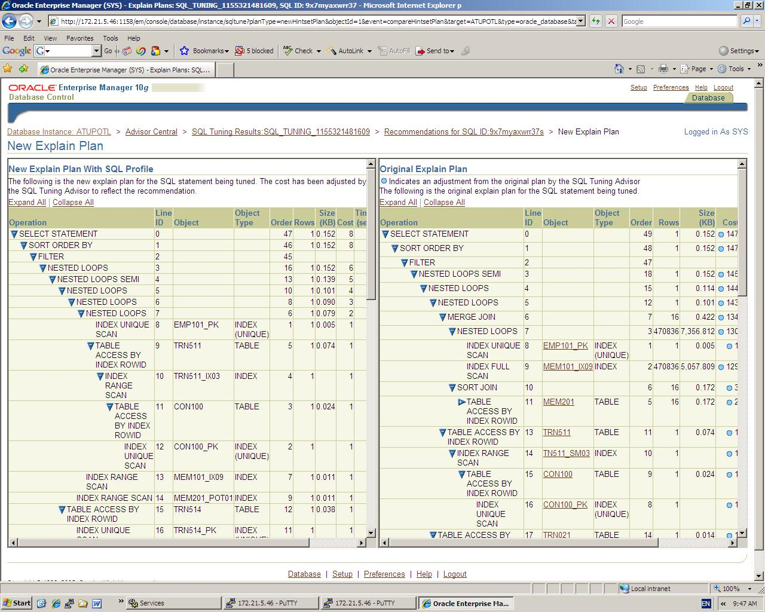
Its really cool….

Slide 64
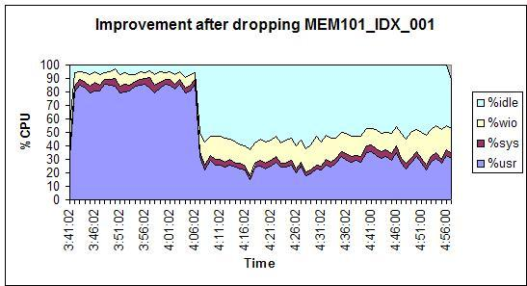
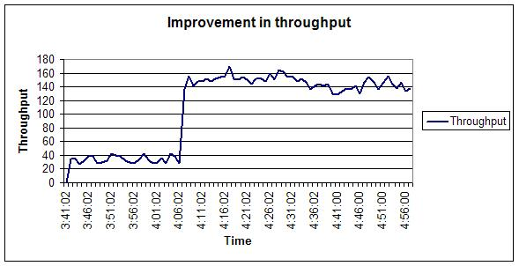
SQL Advisor was used in POT
select * from mem101 where
(mem101_plaide = :1 and (upper( mem101_sta ) = :2 or
upper( mem101_sta ) = :3) and
mem101_credat < :4 + 1 and mem101_pmeide > :5)
order by mem101_pmeide asc
The first execution of the query confused the optimized.
The SQL Tuning Advisor got information from the SQL Access Advisor that only 2000 rows were being fetched at a time.

Slide 65
When do I use these tools ?
For Tuning Individual SQL use:
EXPLAIN PLAN
AUTOTRACE
Get_plan_details
For Tuning multiple SQLs or Profiling use:
STATSPACK
SQL Trace and TKPROF
Tools like Oracle Enterprise Manager and the new 10g SQL Adviser can be used for both these tasks.

Slide 66
Tuning Techniques and Best Practices _{[1], [3], [4], [6], [8]}

Slide 67
Tuning Techniques - NON SQL
Use concatenated indexes
Over indexes to avoid Table lookup if applicable
Advance indexing options where applicable – hash clusters, IOTs, Bitmap indexes,
Avoid unnecessary and frequent commits for batch jobs.
Analyse tables – and compute histograms on columns
Avoid accidental table scans
Filter data in database not Application
Know the joins and use the best one for the job
Options on table – parallel query, Reduce size of table, Keep table, Partitioning
Avoid lock contention
  Use select PK for update instead update PK where PK=PK.
  Use sequence instead of a table based locking strategy
  Use select for update wisely – locks all rows in the where clause
  Index foreign keys

Slide 68
Tuning Techniques – SQL Query
Make use of analyticals
Make use of in-line views
Use alternates of Set operations
  Hash Anti Joins instead of Minus
  Hash Joins instead of Intersect
  Union All instead of Union
Avoid unnecessarity Sort
  Use Distinct wisely
  Use group by wisely
  Use UNION ALL if the query in UNION gets distinct values
  Avoid sort-merge joins
  Use a index sort

Slide 69
SQL Tuning- Best Practices
Design and Develop with performance in mind
Establish a Tuning Methodology
Use SQL Tuning Tools
Profile SQL, Baseline, Measure, tune and Compare
Always measure the performance by running the application
Know the database optimizer
Know SQL tuning techniques and features
Know SQL Joins
Avoid lock/latch contention
Learn database features that will enhance performance
Start using the new ANSI 2002 join syntax

Slide 70
Why are they not Tuned? _{[1]}
Programming tuned SQL is more difficult than functional SQL, there is generally a resistance to not attempt to write tune SQL
  The optimizer will do it for me
    The optimizer does not know the application or data distribution
  I am not a SQL Programmer
    You are responsible for the SQL you write – including performance
  I will write the SQL – someone else can tune it
    You know the specs and the requirements – you are best placed for tuning.
  I will tune it later
    Procrastination thy name!! The longer you wait the more difficult it gets
  We can’t afford to tune it, its waste of time
    SQL Tuning is almost always cost effective. You are making a BIG mistake.

Slide 71
SQL Tuning is almost always a cost effective exercise. It helps avoid costly hardware upgrades and improves the scalability and performance of applications. _{[1]}

Slide 72
References:
[1] Oracle SQL High Performance Tuning – Guy Harrison
[2] Atune POT Report to Developers – Michael Burke
[3] Oracle9i Database Performance Tuning Guide and Reference – Oracle Corporation Part Part Number A96533-02
[4] Oracle Tuning 101 – Gaja Vaidhanatha et. al.
[5] Oracle Performance Tuning – Cary Milsap
[6] Effective Oracle by Design – Tom Kyte
[7] Art and Science of SQL Tuning – Chris Lawson
[8] Oracle® Database Performance Tuning Guide 10g Release 2 – Oracle Corporation Part Part Number B14211-01

Slide 73
Thank You.
All information will be available in Confluence Database space http://aassydv27.aas.priv/confluence/display/aaspiredb/Technical+Session+-+SQL+Tuning
Any Questions ……

